Slide 2
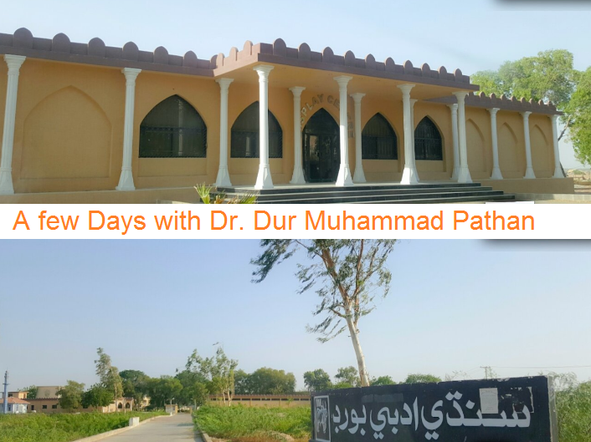

Slide 3
Exchanging,
Sharing & Gaining of Experience.

Slide 4
Training of Sindhi Adabi Board Staff
An Agenda & Initiate
For Better Change

Slide 5
We Need Improvement of
Your dynamic leadership
Your Initiate and efforts
Your Vision & Wisdom
Your talents & Potentialities

Slide 6
We Need Change & We Expect
That with your co-operation & hard work the Board will be having
Clear vision, mission & Objectives
Strong mechanism to develop new a System
Wonderful discipline
Program of professional development
Evaluation system
Good Administration
Best results & Quality assurance

Slide 7
Sindhi Adabi Board
Chair Man
Staff
Secretariat
Editor
Board of Governors
Book shop
Library
Printing & Publication
Web Section
Account

Slide 8
How to know ourselves
SWOT: Strengths, Weaknesses, Opportunities, Threats
PESTEL: Political, Environmental, Social, Technical,Economical, Legal
TPC: Time, Place, Circumstances

Slide 9
Web Section
Topic Some Suggestions For Improvement

Slide 10
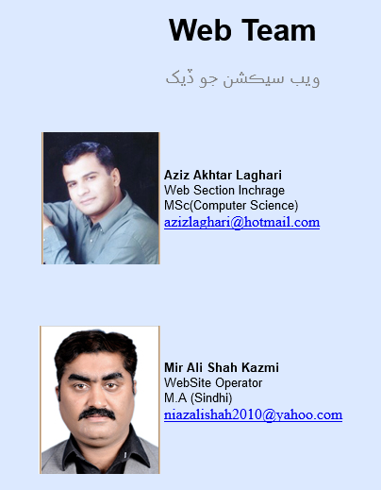
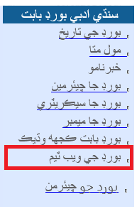
Web Section
Suggestions
No publicity of website team.

Slide 11
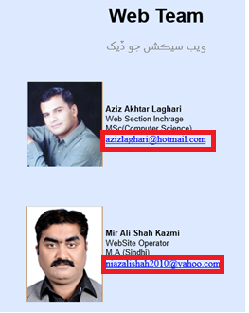
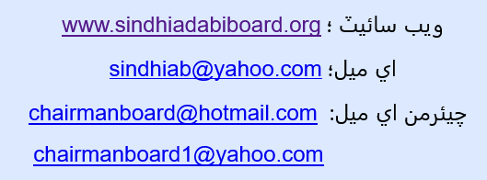
Web Section
Suggestions
No Personal Email Address

Slide 12
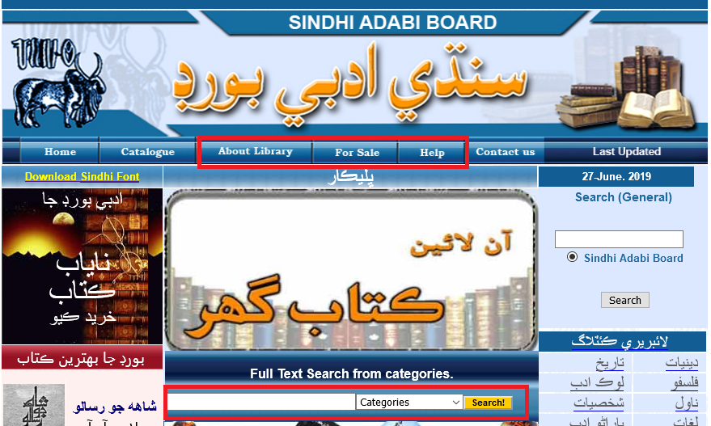
Web Section
Suggestions
Many Buttons Links Are Not Working

Slide 13
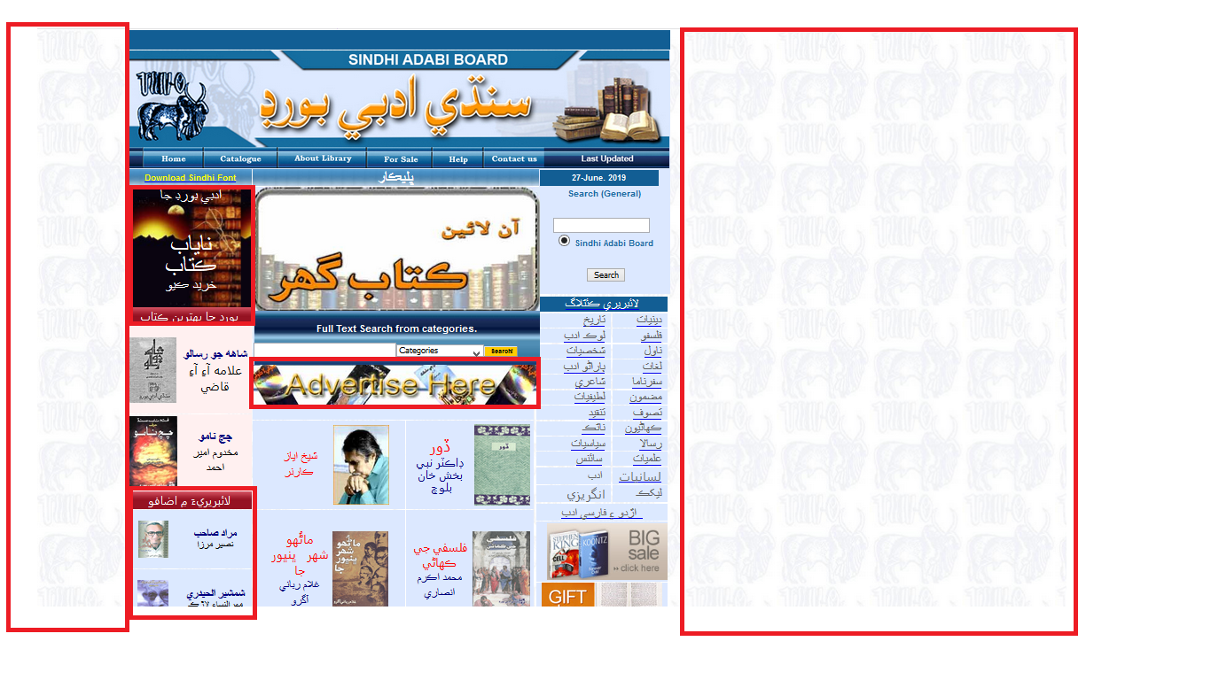
Web Section
Suggestions
Home Redesigned

Slide 14
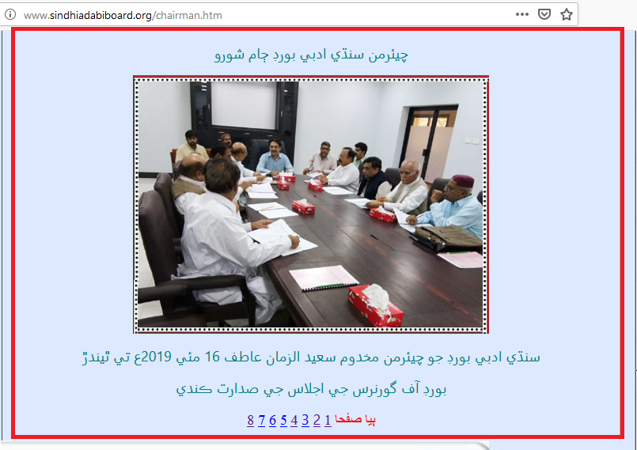
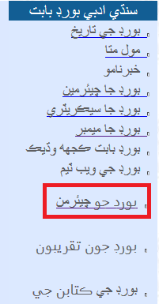
Web Section
Suggestions
Addition of New Button Title of Gallery

Slide 15
Web Section
Suggestions
pending / under construction work complete in time

Slide 16
Web Section
Suggestions
Website emails must be of own Domain but not personal
info@sindhiadabiboard.org
chairman@sindhiadabiboard.org
secretrary@sindhiadabiboard.org

Slide 17
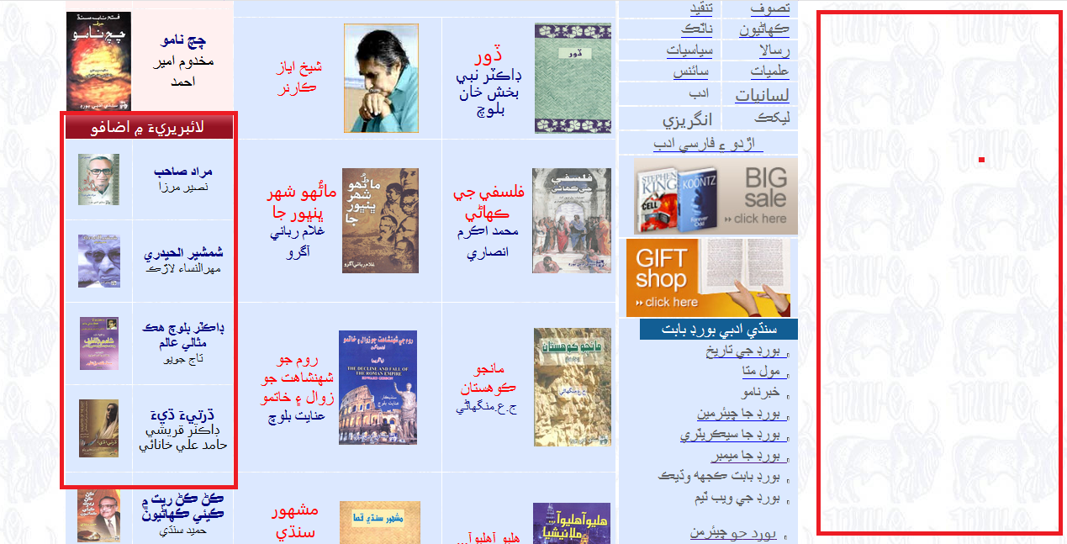
Web Section
Suggestions
New updates be shown on Home page

Slide 18
Web Section
Suggestions
Publicity of books be every changing

Slide 19
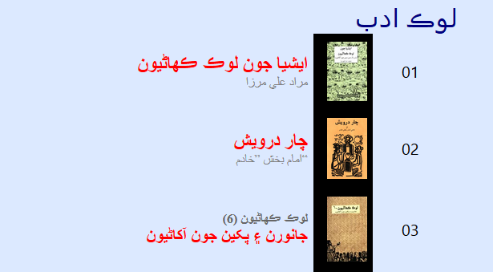
Web Section
Suggestions
Visitor number must be visible on every post

Slide 20
Web Section
Suggestions
Book title images are too small
Text of the book / general when title of the book is clicked

Slide 21
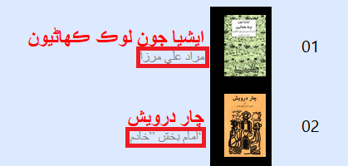
Web Section
Suggestions
When name of author is clicked, the list of his / her must appear

Slide 22
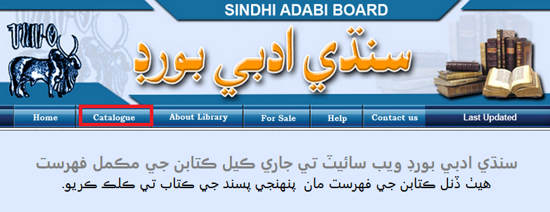
Web Section
Suggestions
The catalogue should be author wise, alphabetical, year wise

